Slide 1
Lab 12: Animations
User Interface Lab: GUI Lab
Nov 11th, 2014

Slide 2
Project Questions?
Anything?

Slide 3
Animation
A series of key frames ticking in a loop

Slide 4
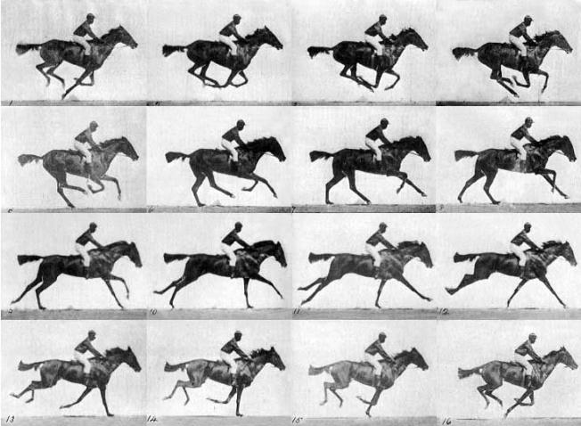
Animation
"Muybridge race horse gallop”

Slide 5
Animation
"Muybridge race horse gallop”
Notes:
this is state-to-state or sprite sheet animation

Slide 6
Animation
Notes:
this is interpolated animation

Slide 7
Interpolation
Having a number change smoothly over a time interval
Essentially defines what a value does between key frames (defined values)
Also called tweening or easing
All animation is interpolation of some kind

Slide 8
Interpolation
//linear interpolation
//where 0 <= time <= 1
function lerp(min, max, time) {
return min + (max – min) * time
}

Slide 9
CSS3 Easing functions
ease – slow-fast-slow
linear – constant speed
ease-in – slow start
ease-out – slow end
ease-in-out – slow start and end != ease
cubic-bezier(n,n,n,n) – custom
see: http://cubic-bezier.com/

Slide 10
Types of Animation in HTML5
CSS3 animation
jQuery animation
jQuery CSS3 hybrids
animation frames

Slide 11
CSS3 Animations
2 flavors
transitions
animations
annoyingly not yet standard
have to include prefixes for maximum compatibility

Slide 12
CSS3 transition
/*basic form*/
selector {
transition: property duration;
-moz-transition:…;
-webkit-transition:…;
}

Slide 13
CSS3 transition
div {
width: 50px;
transition: width 2s;
}
div:hover {
width: 200px;
}

Slide 14
CSS3 transition
div {
width: 50px;
transition: width 2s linear 1s;
}
div:hover {
width: 200px;
}

Slide 15
CSS3 Animations
/*basic animation*/
selection {
animation: animName duration;
-webkit-animation: animName duration;
}

Slide 16
CSS3 Animations
@keyframes animName {
from {/*some css*/}
to {/*some css*/}
}
@keyframes otherAnim {
0% {/*some css*/}
50% {/*some css*/}
100% {/*some css*/}
}
Notes:
from to will do a direct interpolation
percentage will do a non-linear one

Slide 17
CSS3 Animations
Other properties
animation-timing-function: same easing options
animation-iteration-count:
number – repeats that many times
inifinite – runs forever
animation-direction:
normal (from → to | from → to)
reverse (to → from | to → from)
alternate (to → from → to → from)
alternate-reverse (from → to → from → to)
http://www.w3schools.com/css/css3_animations.asp

Slide 18
jQuery Animaton
//basic form
$(selector).animate(/*some css*/);

Slide 19
jQuery Animaton
//basic form
$(“div”).animate({width:“50px”);
$(“#target”).animate(
{height:“200px”},
2000, //in milliseconds
“swing”,
callbackFunction
);

Slide 20
jQuery Animations
Less compatibility problems
Easier to invoke in code
Less easing options (unless you use jQueryUI http://jqueryui.com/easing/)
Limited set of animatable properties (unless you use jQueryUI)

Slide 21
jQuery CSS3 hybrids
Write animations/transitions in CSS, toggle their class using jQuery
css: .my-anim{…}
js: $(“#target”).toggleClass(“my-anim”);
Mostly down to preference

Slide 22
Animation Frames
Run code at the refresh rate of the browser
Allows you to animate anything but you have to write the code to do it
How games and bigger media projects work

Slide 23
Animation Frames
function step(frameTime) {
// do stuff
//re-request to loop
window.requestAnimationFrame(step);
}
window.requestAnimationFrame(step);
Notes:
from to will do a direct interpolation
percentage will do a non-linear one

Slide 24
Questions?

Slide 25
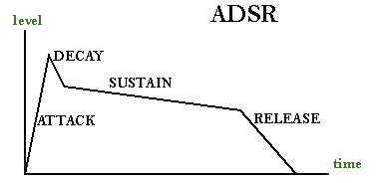
Extra Time
ADSR curves

Slide 26
ADSR Curves
A form of interpolation
Originating from music
Relevant to UI feel

