Slide 1
Lab 2: Forms and Basic Input
User Interface Lab: GUI Lab
Sep. 2nd, 2014

Slide 2
Lab 2 goals
HTML input tags
Layout
JavaScript callbacks
Project 1: Getting Started

Slide 3
In-class Projects (ICP)
Not graded
Will go over material for upcoming labs

Slide 4
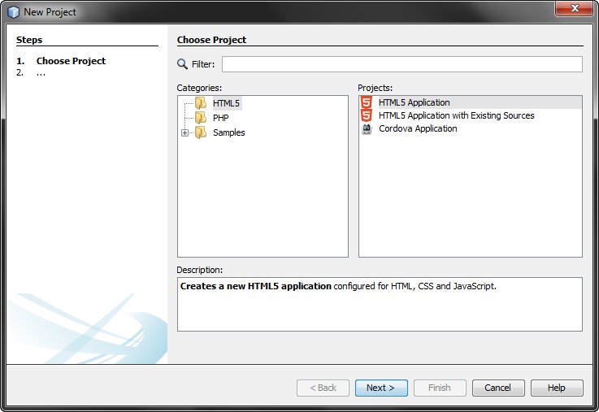
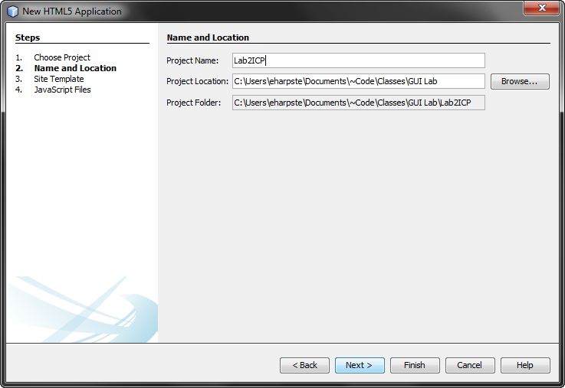
Create a new netbeans project
File > New Project
Choose “HTML5 Application”
Click “Next”
Name: Lab2ICP
Click “Finish”

Slide 5
Lab 2 ICP goal

Slide 6
Worked Example
…

Slide 7
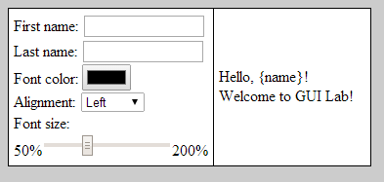
Project 1a
See Assignments page of course website
Turn in via email as a zip
Due by 10:30am, 9/09 via email

