Slide 1
Lab 5: More on Events and Introduction to the Canvas Tag
User Interface Lab: GUI Lab
Sep. 23rd, 2013

Slide 2
Project 2
Project 2 is dues next week
Any Questions?

Slide 3
Lab 5 goals
More on events
Introduction to the Canvas

Slide 4
More on Events
Events have properties that can tell you what is going on
Most commonly used with mouse events to get mouse coordinates

Slide 5
More on Events
<canvas onmousedown=“alertCoords(event)”>
function alertCoords(event) {
var x = event.clientX;
var y = event.clientY;
alert(‘(‘ + x + ’,’ + y + ’)’);
}

Slide 6
More on Events
Event Listeners can also be registered purely in javascript
Only way to add listeners to the window object.

Slide 7
More on Events
window.addEventListener(“mousedown”,
alertCoords,false);
function alertCoords(event) {
var x = event.clientX;
var y = event.clientY;
alert(‘(‘ + x + ’,’ + y + ’)’);
}

Slide 8
<canvas> Tag
Added in HTML5 to support drawing functions present in other systems like flash
Drawing is performed through the canvas’s context object
Drawing primarily done by drawing lines between points

Slide 9
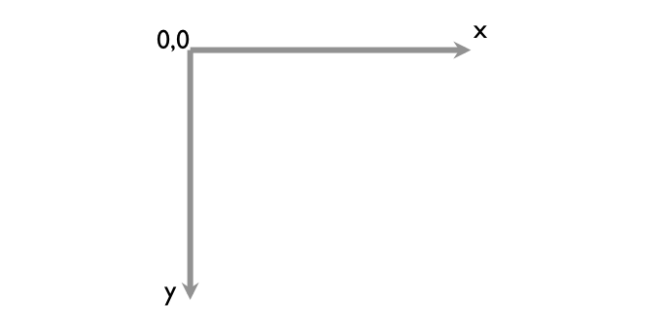
Drawing coordinates

Slide 10
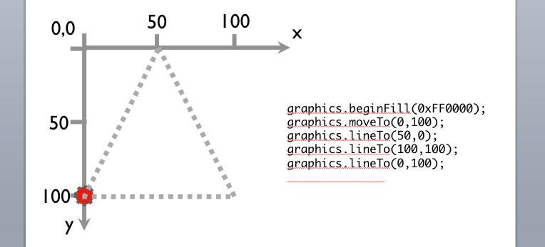
Drawing coordinates

Slide 11
Draw a Triangle
var ctx = canvas.getContext(“2d”);
ctx.beginPath();
ctx.moveTo(0,100);
ctx.lineTo(50,0);
ctx.lineTo(100,100);
ctx.closePath();
ctx.stroke();

